Slide 1
Learning Objective
I will be able to key features of a sideway parabola and square root functions
Success Criteria
At the end of the lesson, I will be able to:
Sketch sideways parabola;
Determine key features of a sideway parabola;
Sketch square root functions.

Slide 2








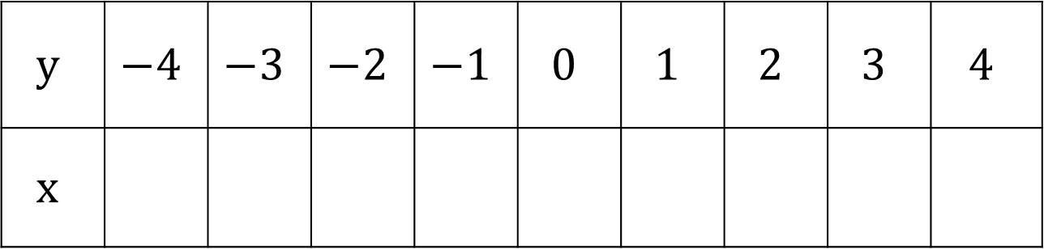

Concept Development
Consider the rule $y^{2}=x$
$$y$$ | $$−4$$ | $$−3$$ | $$−2$$ | $$−1$$ | $$0$$ | $$1$$ | $$2$$ | $$3$$ | $$4$$
$$x$$
$$16$$
$$9$$
$$4$$
$$1$$
$$0$$
$$1$$
$$4$$
$$9$$
$$16$$

Slide 3

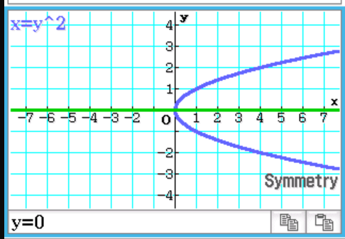
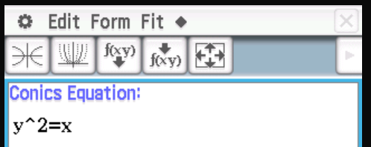
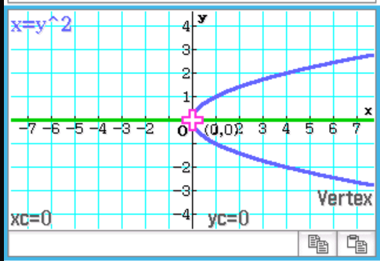
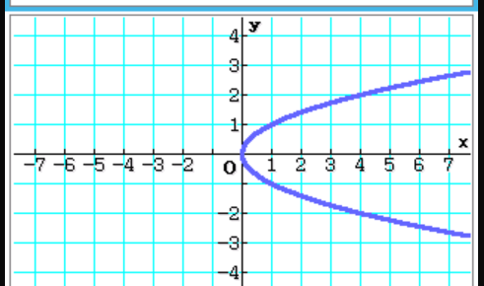
Plotting in ClassPad
Analysis -> G-solve -> Symmetry
Go to
Enter in Equation:$y^{2}=x$
Analysis -> G-solve -> Vertex
S$elect graph icon, y^{2}=x$

Slide 4
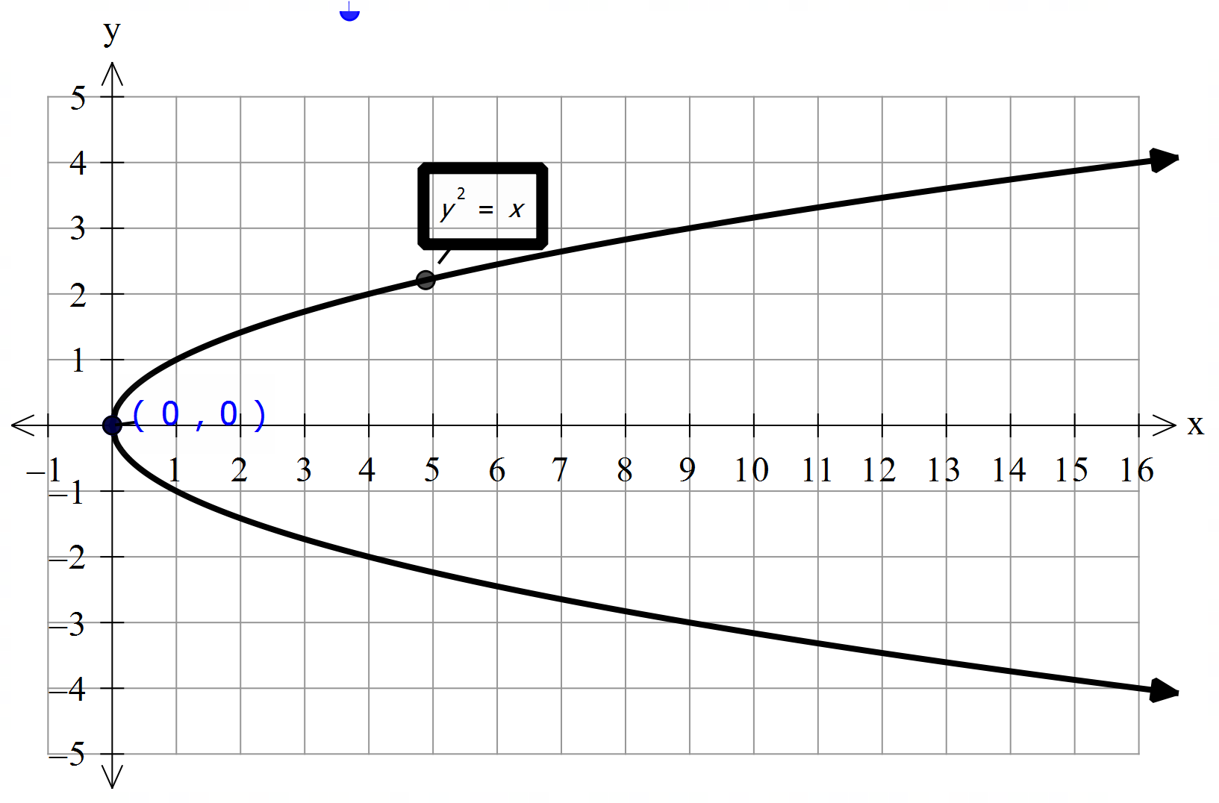





Concept Development
What’s the equation of the line of symmetry?
$$y=0$$
What’s the turning point?
$$(0,0)$$
$$y=0$$
What’s the x- intercept?
$$(0,0)$$
What’s the y- intercept?
$$(0,0)$$

Slide 5

Concept Development
Key features of a sideways parabola graph:
Line of Symmetry
Turning Point
Any $x−$ and $y−$ intercepts
$$y=0$$

Slide 6
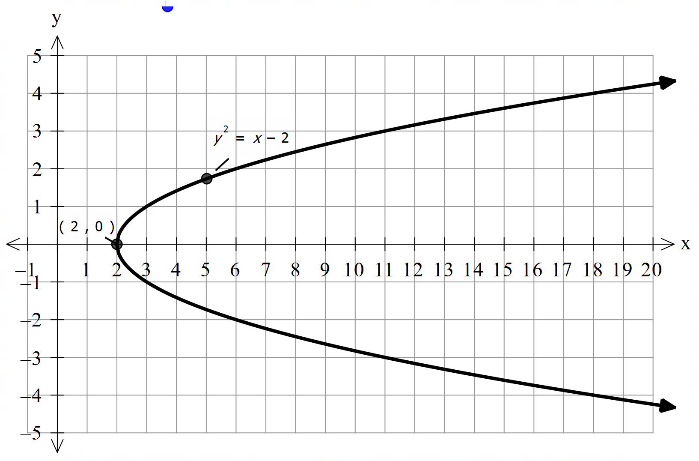





Concept Development
Sketch the rule $y^{2}=x−2$
What’s the transformation?
Graph translates horizontally to the right by 2 units
What’s the equation of the line of symmetry?
$$y=0$$
What’s the turning point?
$$(2,0)$$
$$y=0$$
What’s the x- intercept?
$$(2,0)$$
What’s the y- intercept?
$$None$$

Slide 7
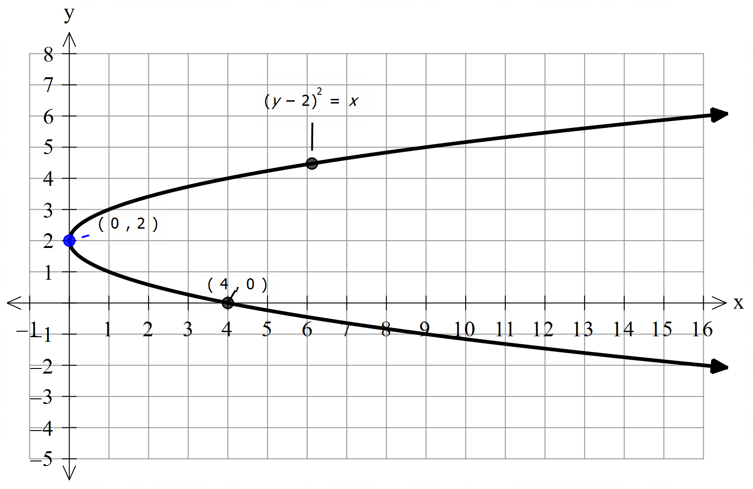





Concept Development
Sketch: ${(y−2)}^{2}=x$
What’s the transformation?
Graph translates vertically up by 2 units
What’s the equation of the line of symmetry?
$$y=2$$
What’s the turning point?
$$(0,2)$$
$$y=2$$
What’s the x- intercept?
$$(4,0)$$
What’s the y- intercept?
$$(0,2)$$

Slide 8
General Form
$${(y−h)}^{2}=x−k$$
What’s the transformation?
Graph translates vertically up by 2 units
What’s the equation of the line of symmetry?
$$y=2$$
What’s the turning point?
$$(0,2)$$
$$y=2$$
What’s the x- intercept?
$$(4,0)$$
What’s the y- intercept?
$$(0,2)$$

Slide 9
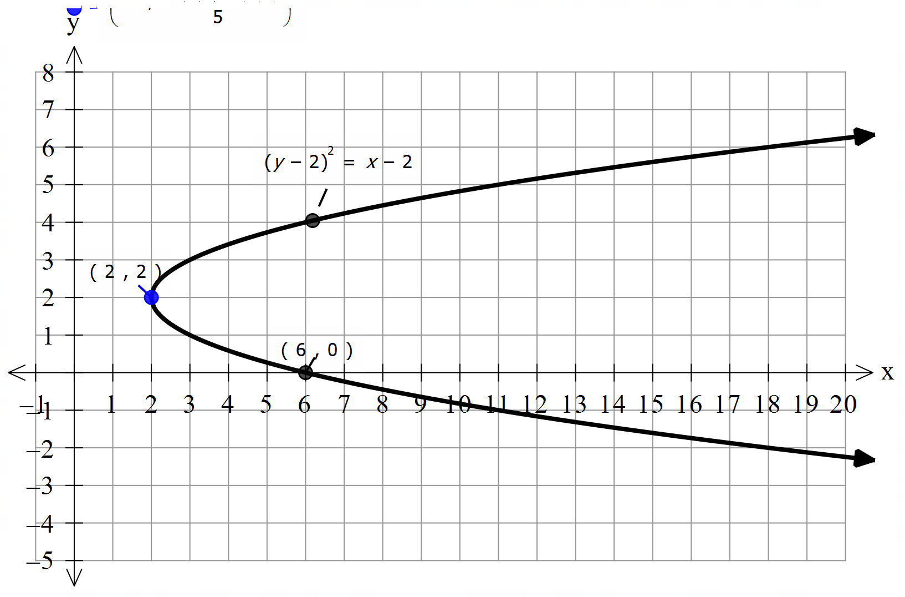





Concept Development
Sketch ${(y−2)}^{2}=x−2$
What’s the transformation?
Graph translates horizontally to the right by 2 units
Graph translates vertically up by 2 units
What’s the equation of the line of symmetry?
$$y=2$$
What’s the turning point?
$$(2,2)$$
$$y=2$$
What’s the x- intercept?
$$(6,0)$$
What’s the y- intercept?
$$None$$

Slide 10



General Form of Sideway Parabola
Sketch ${(y−k)}^{2}=x−h$
What’s the transformation?
h>0: Graph translates horizontally to the right by h units
h<0: Graph translates horizontally to the left by h units
k>0: Graph translates vertically up by k units
k<0: Graph translates vertically down by k units
What’s the equation of the line of symmetry?
$$y=k$$
What’s the turning point?
$$y=2$$
$$(h,k)$$
What’s the x- intercept?
Substitute y = 0
What’s the y- intercept?
$$\text{Substitute} \text{x}\text{ = 0}$$

Slide 11
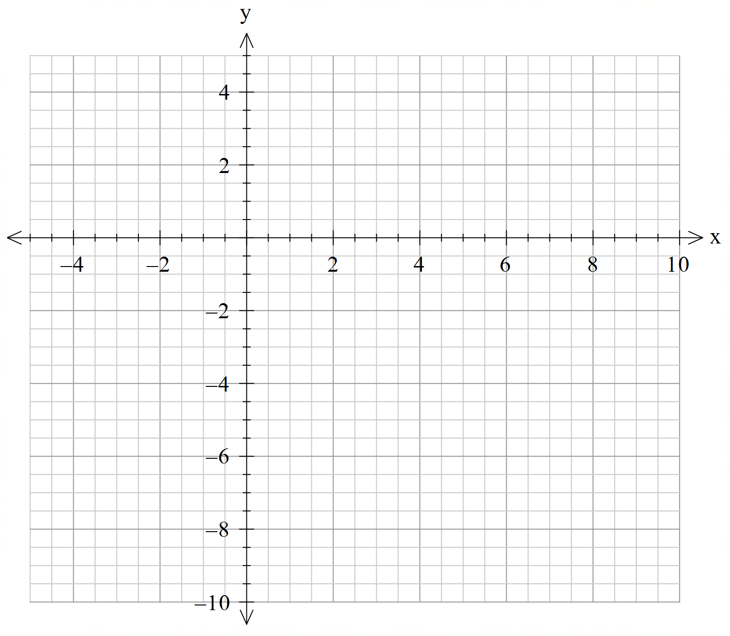
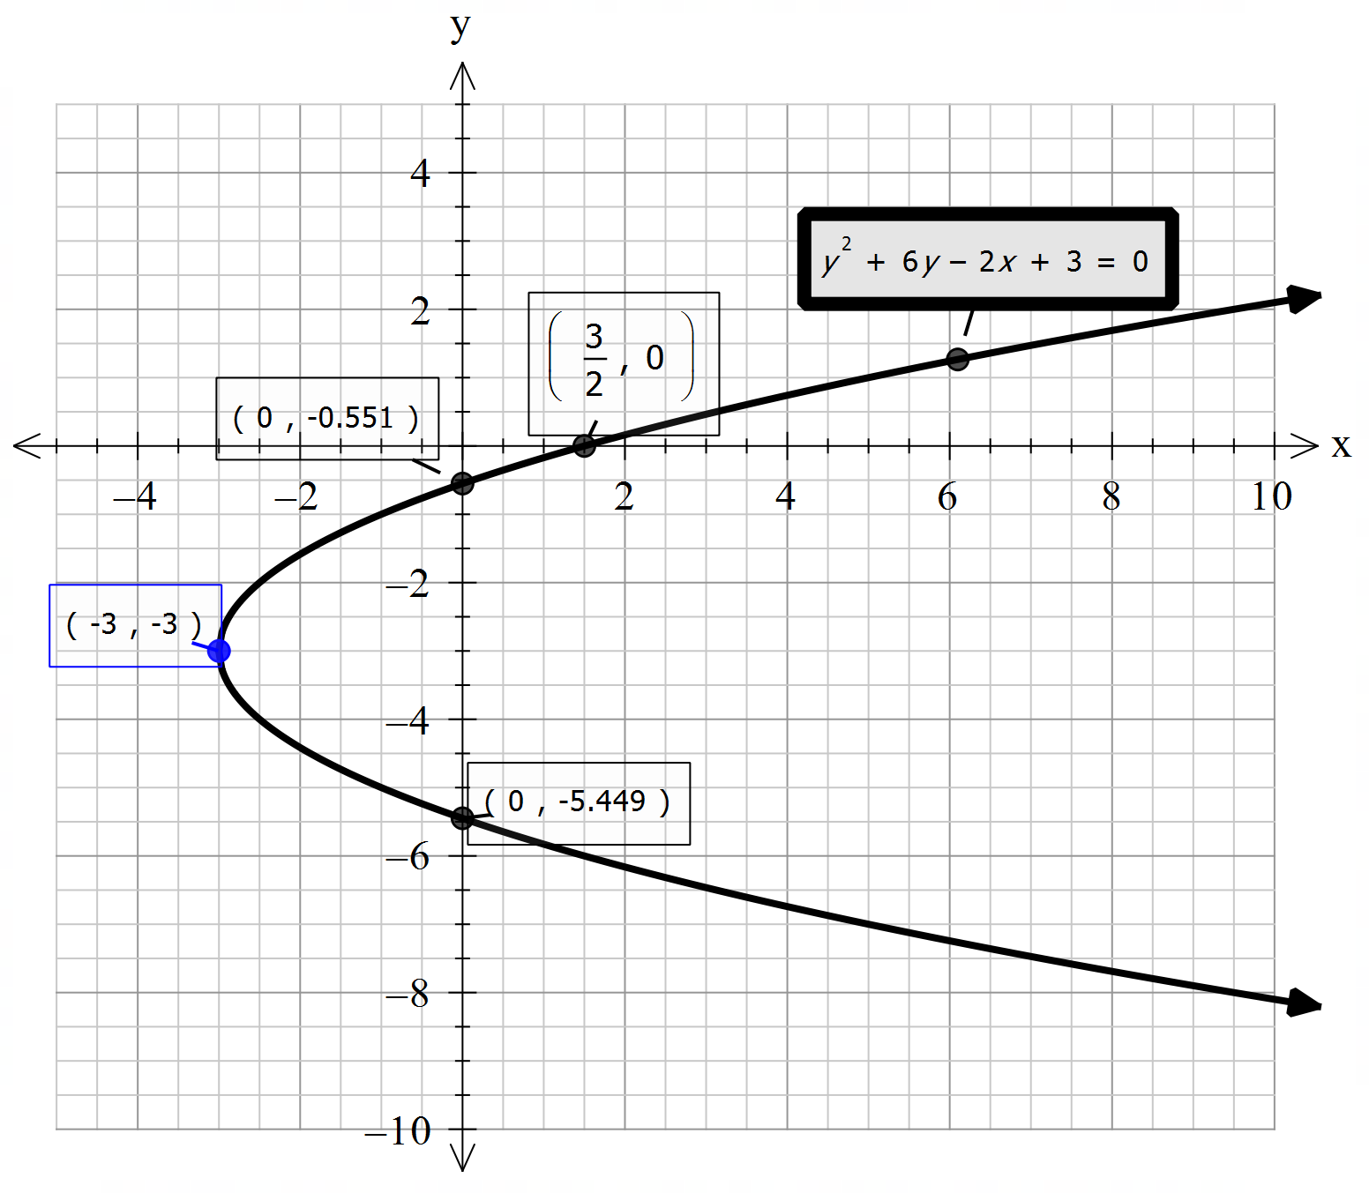
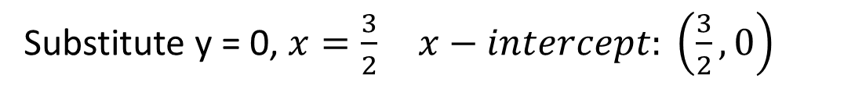



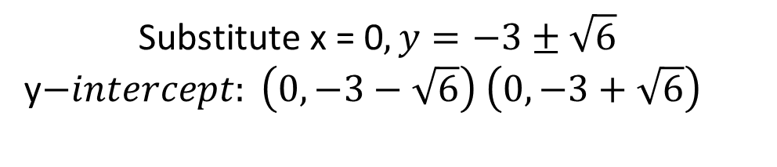
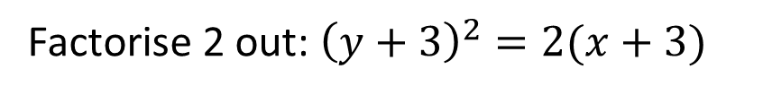
Cambridge Ex 4B Q1j
Sketch $y^{2}+6y−2x+3=0$
Rearrange equation of the form ${(y−k)}^{2}=x−h$
$$y^{2}+6y=2x−3$$
Complete the square on y-side ${\left(y+3\right)}^{2}−9=2x−3$
$${\left(y+3\right)}^{2}=2x+6$$
Factorise 2 out: ${\left(y+3\right)}^{2}=2(x+3)$
Line of symmetry: $y=−3$
TP: $(−3,−3)$
Substitute y = 0, $x=\frac{3}{2} x−intercept: \left(\frac{3}{2},0\right)$
$$\text{Substitute} \text{x}\text{ = 0}, y=−3±\sqrt{6}$$
y$−intercept: \left(0,−3−\sqrt{6}\right)$ $\left(0,−3+\sqrt{6}\right)$

Slide 12
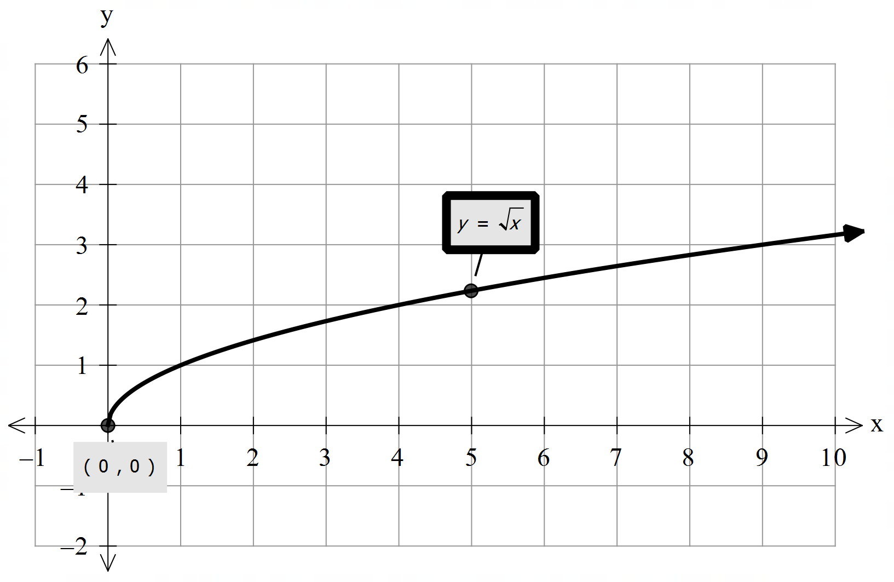



Concept Development
Square Root Functions – upper half of the sideways parabola
Consider the rule $y=\sqrt{x}$
What possible x values can the graph take? $x≥0$
Which coordinate does the graph start at?
$$(0,0)$$
This is going to be your key coordinate.
What’s the x- intercept?
$$(0,0)$$
What’s the y- intercept?
$$(0,0)$$

Slide 13
Concept Development
Key features of a square root function:
Starting point
Any $x−$ and $y−$ intercepts
2 other visible coordinates – (Sketch with 3 coordinates)
$$y=0$$

Slide 14
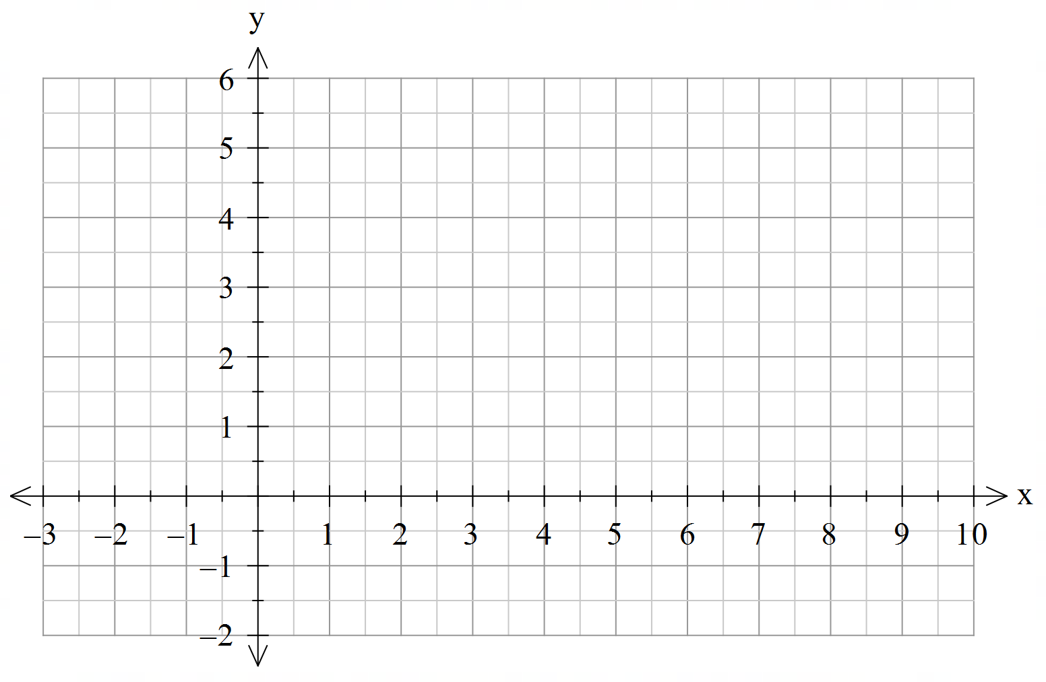
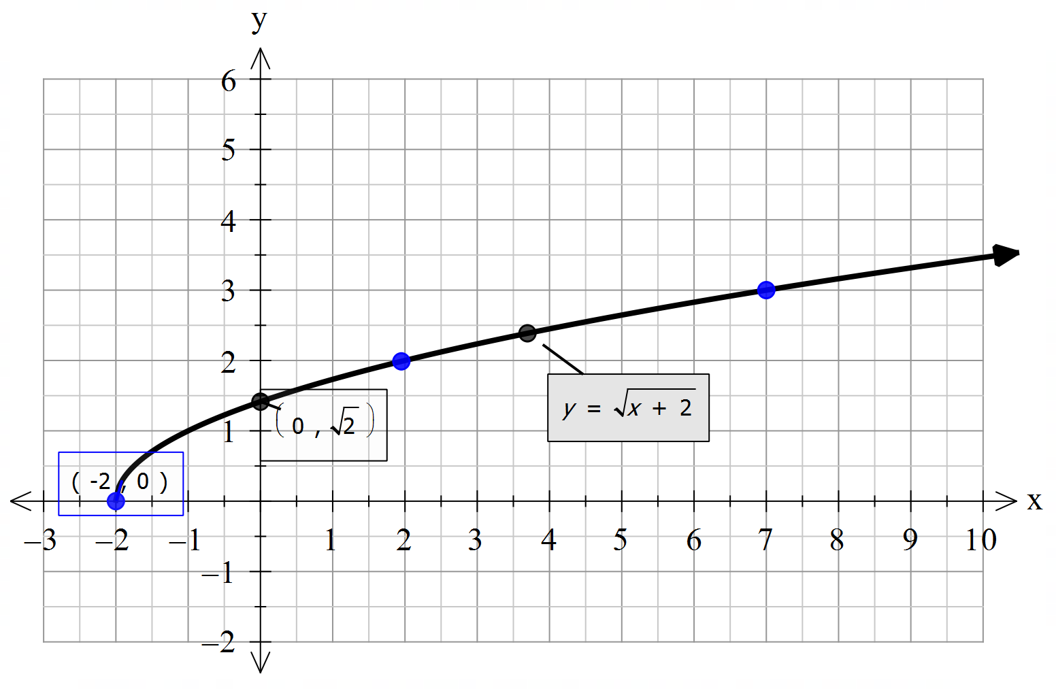





Concept Development
Sketch the graph $y=\sqrt{x+2}$
Possible x-values: $x≥−2$
What’s the transformation?
Graph translates horizontally to the left by 2 units
Which coordinate does the graph start at?
$$(−2,0)$$
What’s the x- intercept?
$$(−2,0)$$
What’s the y- intercept?
$$(0,\sqrt{2})$$
Determine another 2 coordinate?
$$\left(2,2\right), (7,3)$$

Slide 15
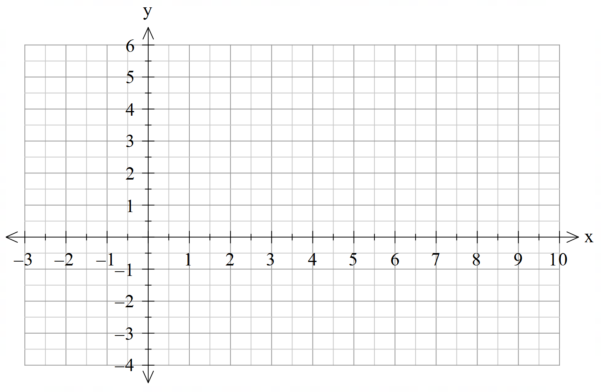
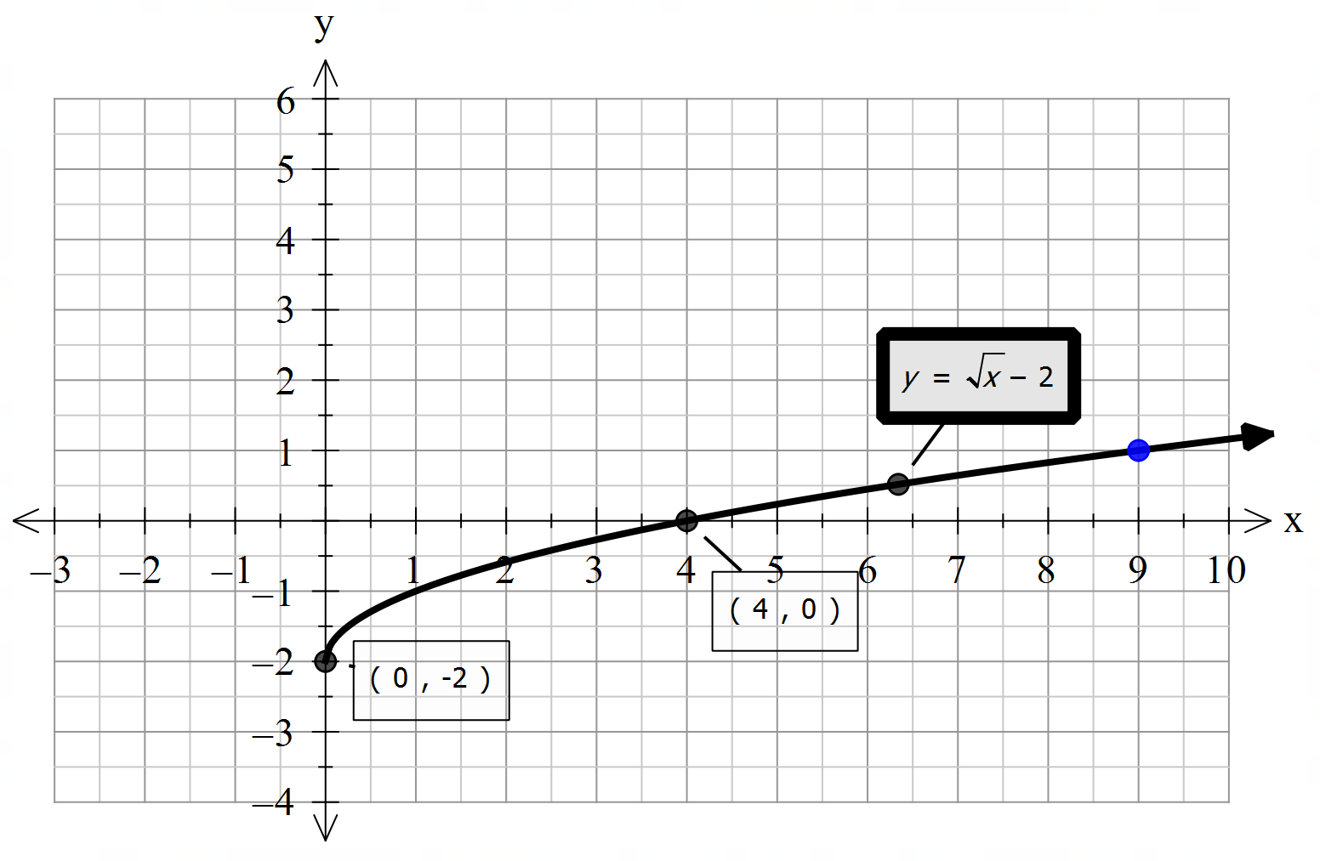





Concept Development
Possible x-values: $x≥0$
Sketch the graph $y=\sqrt{x}−2$
What’s the transformation?
Graph translates vertically down by 2 units
Which coordinate does the graph start at?
$$(0,−2)$$
What’s the x- intercept?
$$(4,0)$$
What’s the y- intercept?
$$(0,−2)$$
Determine another coordinate?
$$(9,1)$$

Slide 16
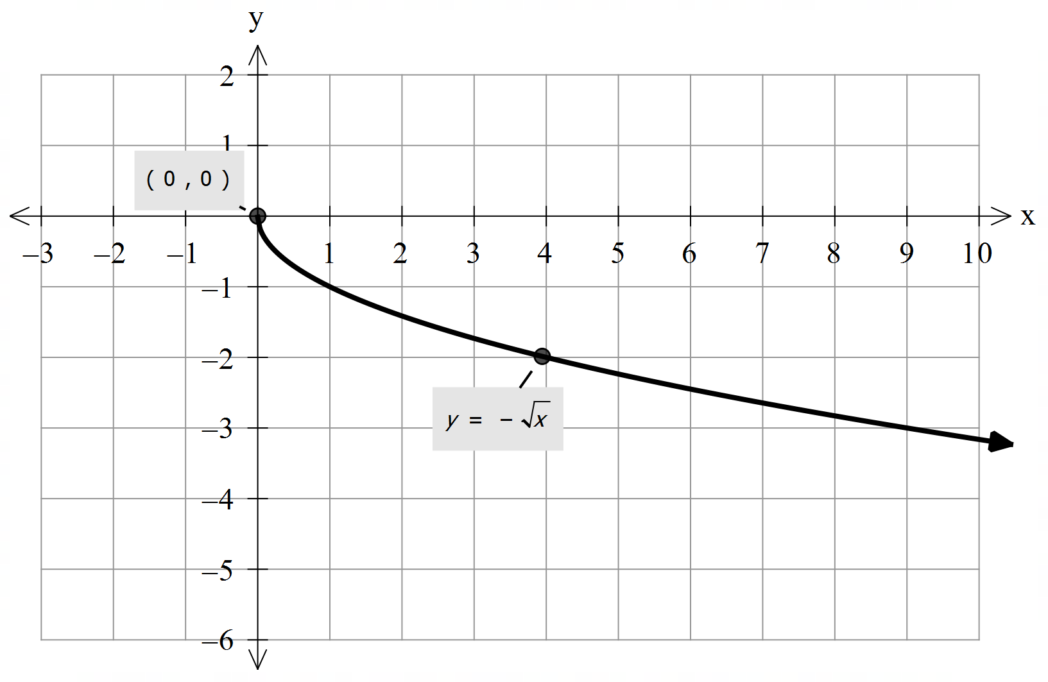




Concept Development
Possible x-values: $x≥0$
Consider the rule $y=−\sqrt{x}$
What’s the transformation?
Graph reflected about the x-axis
Where does the graph start?
$$(0,0)$$
What’s the x- intercept?
$$(0,0)$$
What’s the y- intercept?
$$(0,0)$$

Slide 17
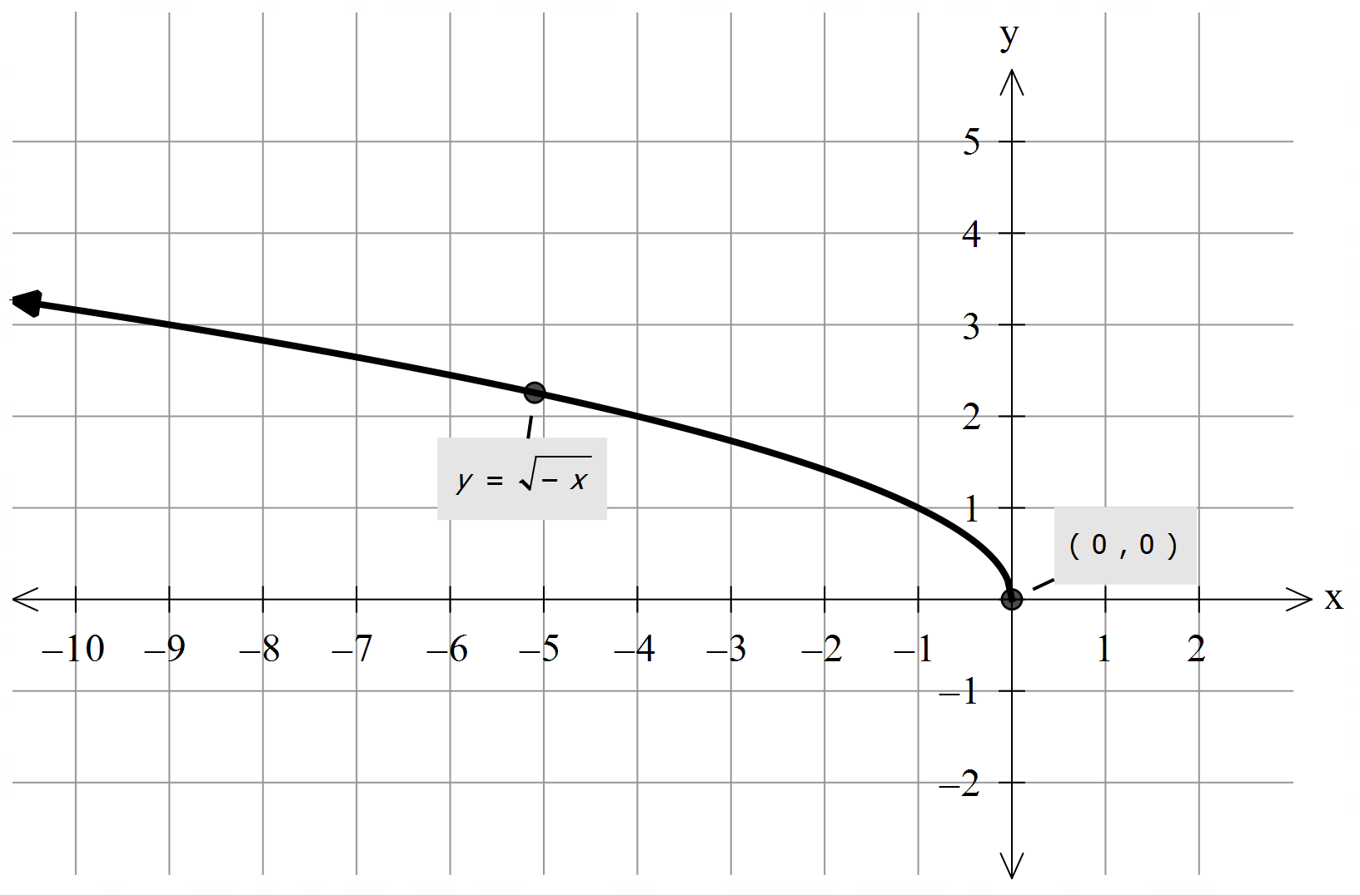




Concept Development
Possible x-values: $x≤0$
Consider the rule $y=\sqrt{−x}$
What’s the transformation?
Graph is reflected about the y-axis
Where does the graph start?
$$(0,0)$$
What’s the x- intercept?
$$(0,0)$$
What’s the y- intercept?
$$(0,0)$$

Slide 18



General Form of Square root Functions
$$y=a\sqrt{x−h}+k$$
Possible x-values: $x≥h$
What’s the transformation?
a>0: Graph is dilated parallel to the y-axis by a factor of a
a<0: Graph is reflect about the x-axis
h>0: Graph translates horizontally to the right by h units
h<0: Graph translates horizontally to the left by h units
k>0: Graph translates vertically up by k units
k<0: Graph translates vertically down by k units
What’s the starting point of graph?
$$(h,k)$$
What’s the x- intercept?
Substitute y = 0
$$\text{Substitute} \text{x}\text{ = 0}$$
What’s the y- intercept?
For $y=\sqrt{−x}$, Graph is reflected about the y-axis

Slide 19
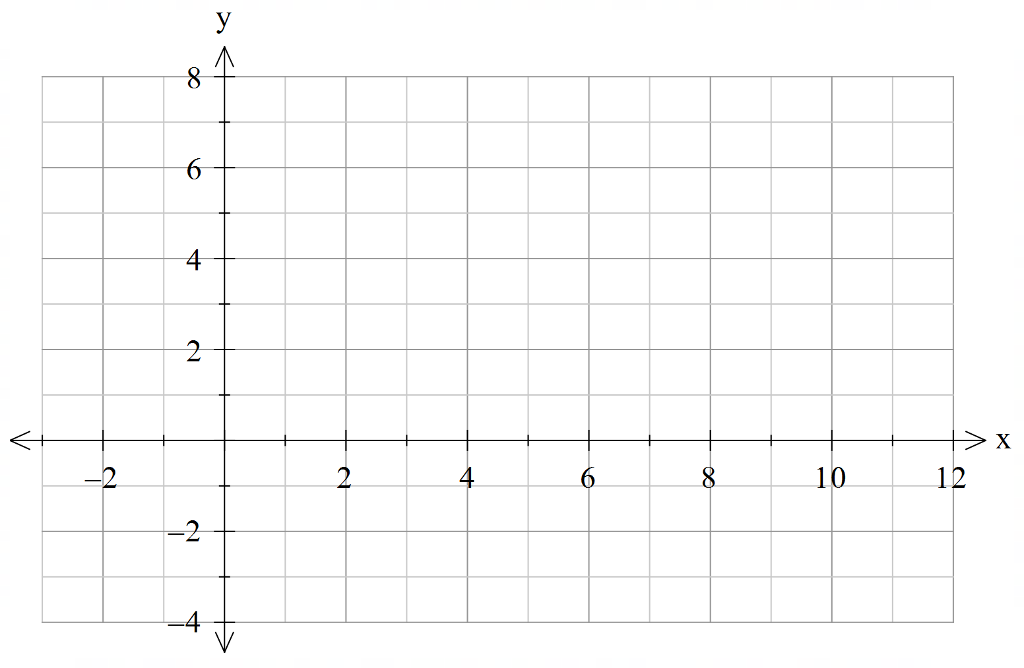
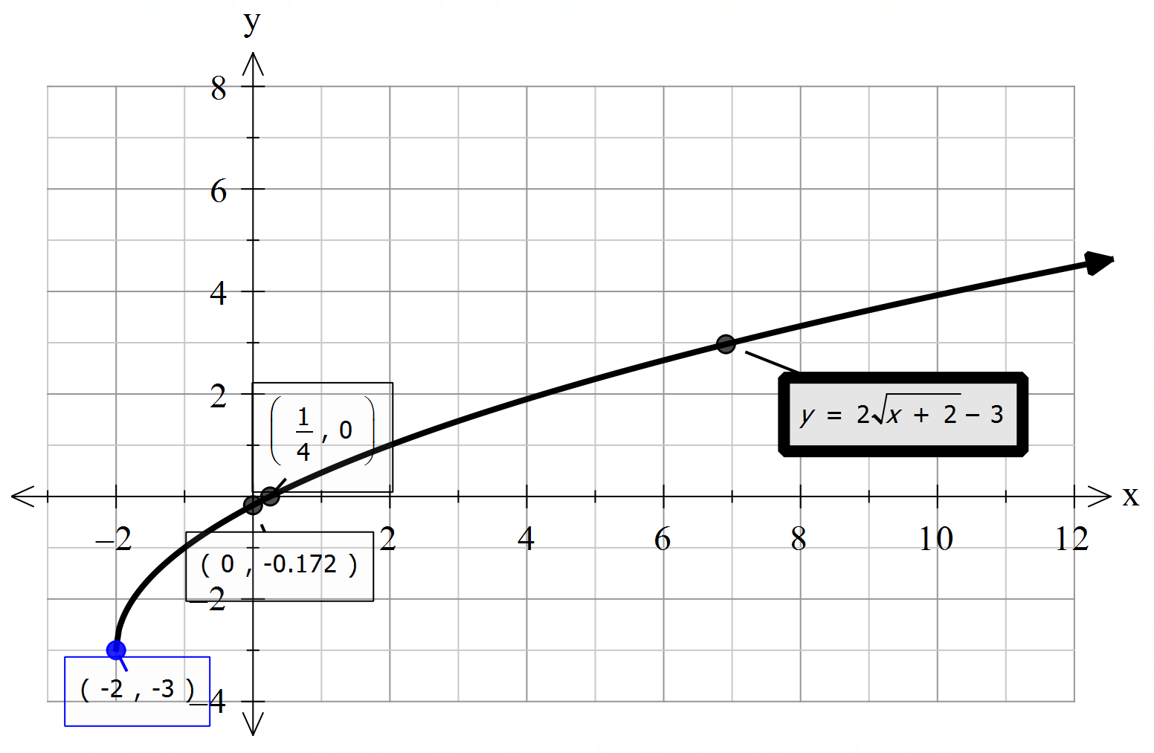
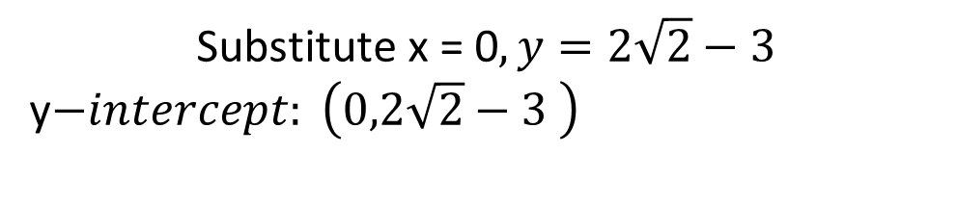
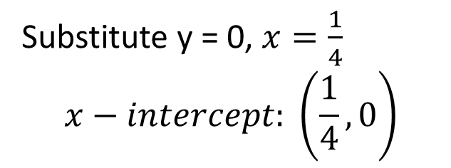


Cambridge Ex 4C Q1f
Sketch $y=2\sqrt{x+2}−3$
Possible x-values: $x≥−2$
Starting Point: $(−2,−3)$
$$\text{Substitute} \text{x}\text{ = 0}, y=2\sqrt{2}−3$$
y$−intercept: \left(0,2\sqrt{2}−3 \right)$
Substitute y = 0, $x=\frac{1}{4}$ $$x−intercept: \left(\frac{1}{4},0\right)$$
Other visible coordinates are: (2,1) (7,3)

Slide 20
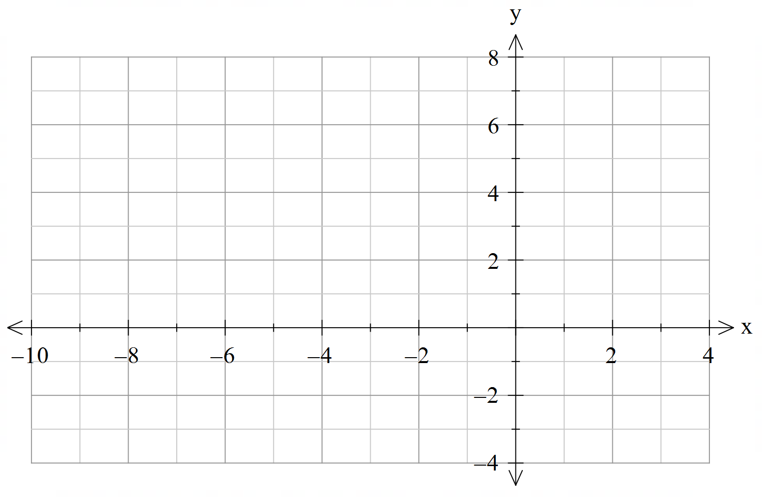
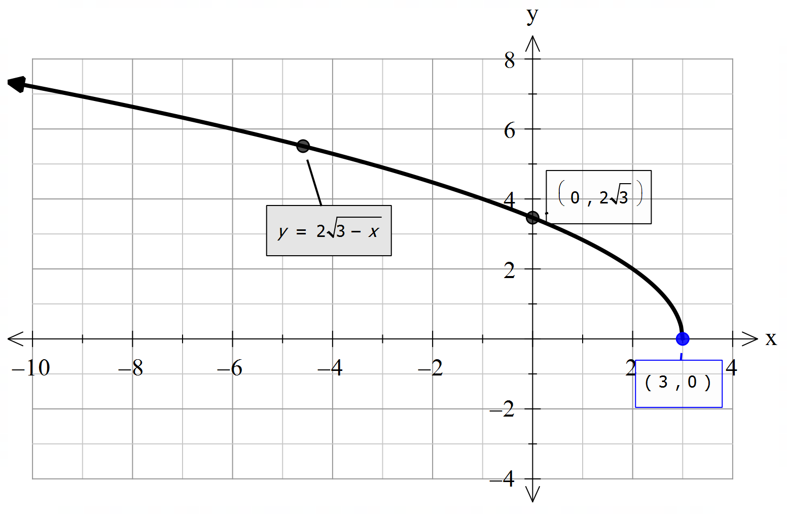


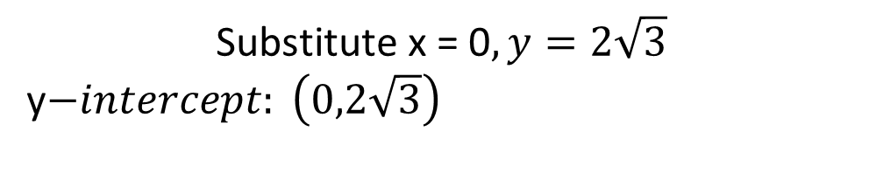

Cambridge Ex 4C Q2d
Sketch $y=2\sqrt{3−x}$
Substitute y = 0, $x=3 x−intercept: \left(3,0\right)$
Rewrite equation: $y=2\sqrt{−(x−3)}$
Other visible coordinates are: (2,2) (-1,4), (-6,6)
Possible x-values: $x≤3$
Graph is reflected about y-axis
Starting Point: $(3,0)$
$$\text{Substitute} \text{x}\text{ = 0}, y=2\sqrt{3}$$
y$−intercept: \left(0,2\sqrt{3}\right)$

Slide 21






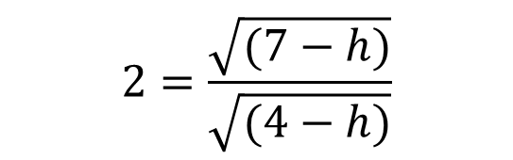

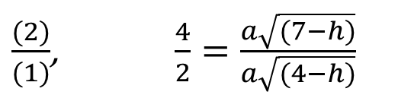


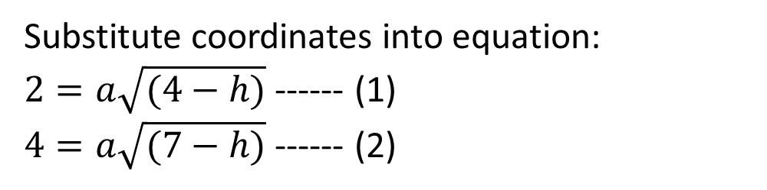


Cambridge Ex 4E Example 14
A graph which has the rule $y=a\sqrt{x−h}$ passes through the points (4,2) and (7,4). Find the values of $a$ and $h$.
Substitute coordinates into equation:
$2=a\sqrt{(4−h)}$ ------ (1)
$4=a\sqrt{(7−h)}$ ------ (2)
$$16−4h=7−h$$
$$4h−h=16−7$$
$\frac{(2)}{(1)}$, $\frac{4}{2}=\frac{a\sqrt{(7−h)}}{a\sqrt{(4−h)}}$
$$3h=9$$
$$h=3$$
$$2=\frac{\sqrt{(7−h)}}{\sqrt{(4−h)}}$$
Subst $h=3$ into (1)
$$2=a\sqrt{4−3}$$
$$2\sqrt{(4−h)}=\sqrt{(7−h)}$$
$$a=2$$
Square both sides, ${\left(2\sqrt{\left(4−h\right)}\right)}^{2}={\left(\sqrt{\left(7−h\right)}\right)}^{2}$
$$y=2\sqrt{x−3}$$
$$4\left(4−h\right)=7−h$$

Slide 22
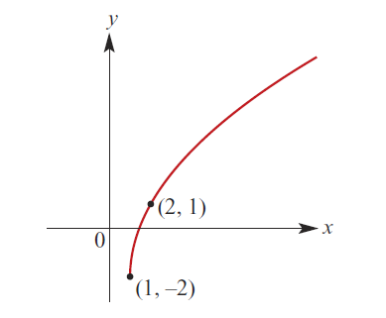
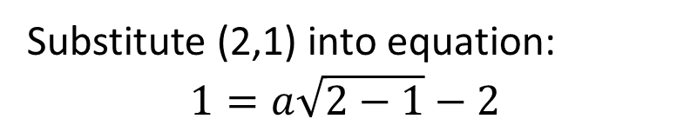





Cambridge Ex 4E Q14 b
Determine the rule of the graph $y=a\sqrt{x−h}+k$ seen below.
$$\left(h,k\right)=(1,−2)$$
$$h=1, k=−2$$
$$y=a\sqrt{x−1}−2$$
Substitute (2,1) into equation:
$$1=a\sqrt{2−1}−2$$
$$1=a\sqrt{1}−2$$
$$a=3$$
$$y=3\sqrt{x−1}−2$$

Slide 23
Independent Practice
Cambridge Ex 4B and 4C

